Slide 1






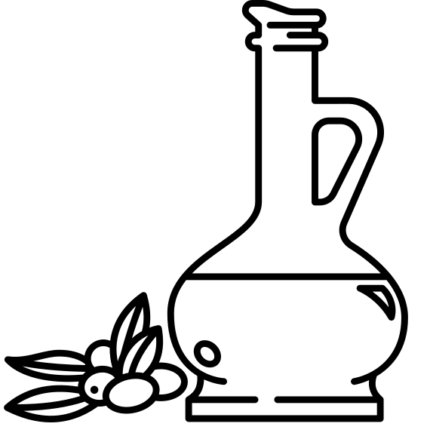
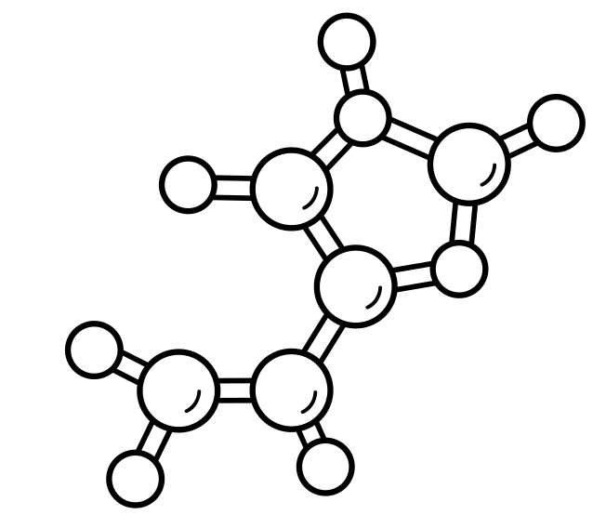
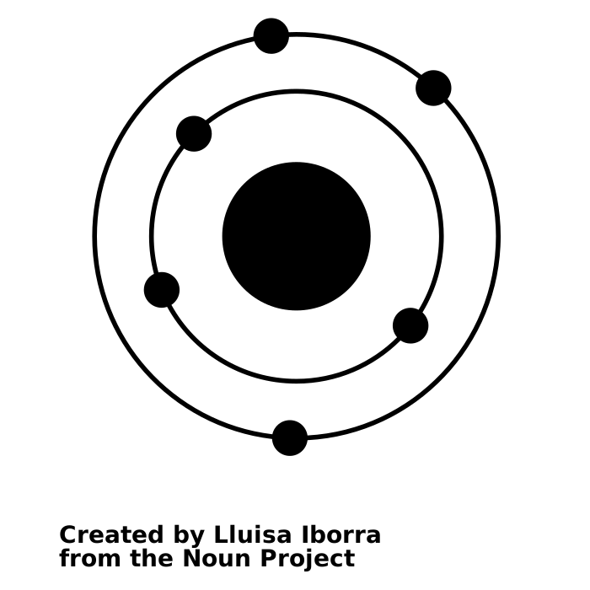
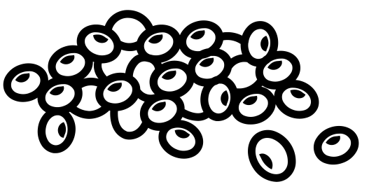

Policy Brief
Brief prepared: August 2022
What does the science mean? Potential applications
DELTA Model® - understanding how global food production can meet the nutritional needs of the global population
Shows how Aotearoa’s food production contributes to global nutrition.
Can predict nutrient supply in simulated scenarios that may occur with changes in production or through environmental shocks.
Can guide targeted changes to production and supply to achieve nutritional goals.
Interested to find out more?
www.sustainablenutritioninitiative.com
Contact: Nick W Smith, N.W.Smith@massey.ac.nz, 0000-0002-6230-4355
or Warren C McNabb, W.McNabb@massey.ac.nz, 0000-0003-2514-6551
Contributors:
Andrew J Fletcher,
Lakshmi A Dave, 0000-0003-0271-4296
Jeremy P Hill,
What is the context of the issue?
Overview
The current global food system is not environmentally or nutritionally sustainable. There are many proposals for change, which are largely prescriptive.
The DELTA Model® is a new, freely-accessible online tool for testing how food system scenarios meet the nutritional needs of the global populations, allowing users to explore changes themselves.
Key results include the current global undersupply of specific micronutrients (calcium and vitamin E); the inefficacy of waste reduction in addressing these deficits; and, the degree of changes necessary to feed larger future populations.
More than 800 million people face some form of undernourishment, with this number expected to rise.^{1,2} Nutrition for all is a key element of sustainability for the global food system, and its absence has severe consequences for human health, economic development, and global social stability.³ Nutritional considerations are often lacking when defining a sustainable food system⁴ This policy brief summarises the use and results of the DELTA Model®, a freely-available online tool for examining how the global food system meets the nutritional needs of the global population now and in the future.
Definitions:
Nutrients
What we did
Macronutrients
Main source of energy
Needed in g per day
Micronutrients
Main source of energy
Needed in g per day
Using international food production, waste and use data, coupled with demographic and nutrient requirement data, we developed a computational model for the global food system. The model takes food production and waste scenarios as inputs and calculates whether the global population could be adequately nourished.
Mg
Takeaways from our research
Carbohydrates
Proteins
Fats
Vitamins
Minerals
There is currently insufficient calcium and vitamin E available to meet the requirements of the global population.
Keywords:
Food production Sustainability
Nutrition Nutrients
Micronutrients Macronutrients
Global food Modelling
Dates: Brief prepared: 16 August 2022
Research undertaken: January 2019 – March 2021
Published in Journal of Nutrition: June 2021
Nutritional shortfalls persist or grow when simulating:
an increase in plant protein production at the expense of meat.
replacing sugar production with more nutritious plant material.
scaling up food production at the same rate as population change.
All Macronutrients
66% Calcium
19% Vit E
The global population is supplied with an excess of all dietary macronutrients (e.g. energy, protein).
Only 66% of the global calcium requirement and 19% of the global vitamin E requirement were supplied.
Disclosure: Andrew J Fletcher and Jeremy P Hill are employees of Fonterra Cooperative Ltd.
References
1 Development Initiatives. 2020 Global Nutrition Report: Action on equity to end malnutrition., (Bristol, UK, 2020).
2 FAO, IFAD, UNICEF, WFP & WHO. The State of Food Security and Nutrition in the World 2020. Transforming food systems for affordable healthy diets., (FAO, Rome, 2020).
3 High Level Task Force of Global Food and Nutrition Security. All food systems are sustainable. (United Nations, 2015).
4 Smith, N. W., Fletcher, A. J., Dave, L. A., Hill, J. P. & McNabb, W. C. Use of the DELTA Model to Understand the Food System and Global Nutrition. The Journal of Nutrition, doi:10.1093/jn/nxab199 (2021). Publication supporting research
Many individuals will have deficiencies or surpluses that do not match the global situation; this is reflective of unequitable food distribution. These results should be seen as representative of the global supply and requirement situation, not the percentage of the population with a nutrient deficiency.
Feel free to use this example freely, but please acknowledge the Office of the Prime Minister’s Chief Science Advisor and the Riddet Institute – Hannah McKerchar

Slide 2
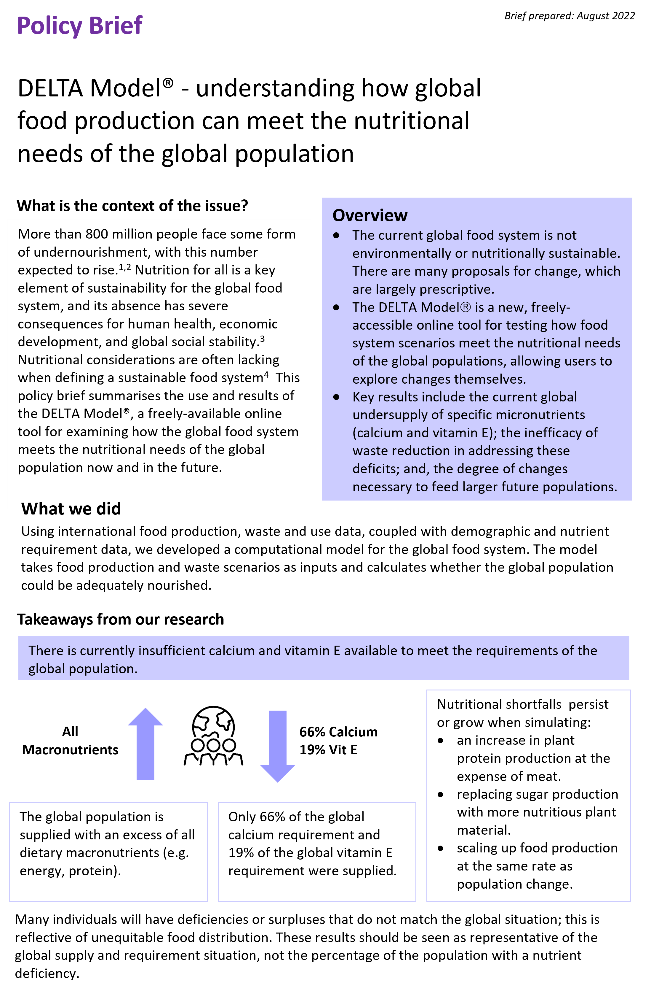
You can refer to the following examples and use a template to create your own Policy Brief.
Templates are available in Word and PowerPoint.
The numbers in the boxes (1-6) relate to the numbering used in the Guide under the heading 'Structure of the Policy Brief’.
Date of document
Page 1
Short, descriptive title
1. Overview that outlines the key points of the briefing. Highlighted for impact.
2. Provide context required to understand the topic.
3. What did you do? Description of research.
4. What did you find?
Key takeaway of the study in one sentence. Highlighted for impact.
4. Use icons, charts, graphs, maps to help explain information. You can search for icons at nounproject.com.
4. Additional details of key takeaways of study in 3- 4 points
4. Summary that critically assesses the study
Feel free to use this example freely, but please acknowledge the Office of the Prime Minister’s Chief Science Advisor and the Riddet Institute – Hannah McKerchar

Slide 3
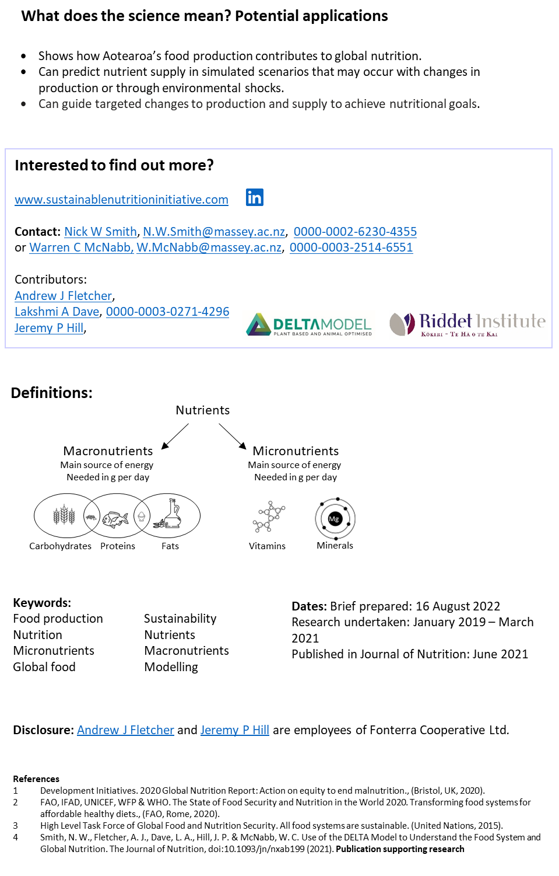
Create an account and search/download icons (like those used in the example) from NounProject.com to represent key takeaways and definitions. The site has millions of icons to choose from. Adjust the color of the icons, download, and upload them to PowerPoint or Word.
Page 2
6. Showcase real-world applications. Suggest a range of applications.
Clearly list who to contact, hyperlink to research organisation. Include Orcid number.
Hyperlink to information on research and educational material.
List team members and contributors.
Highlight contact details, you want to be easily contacted.
Define technical terms that are not widely known.
List date brief prepared and any updates, when research undertaken and when research published.
Keywords, avoid technical terms.
Note any conflicts of interest or association to industry.
References, highlight publication supporting research in brief
Feel free to use this example freely, but please acknowledge the Office of the Prime Minister’s Chief Science Advisor and the Riddet Institute – Hannah McKerchar

